Slide 1
Master Artifact
VDS
Native Library
Andrew Pendleton
CX Design Systems
Core Product
Project

Slide 2

VDS Native Library
VDS Product: Functional Expansion
Workstream Lead: Andrew Pendleton
Initiative Lead: Andrew Pendleton
Northstar
Scope
Results
The Idea
Problem & Opportunity
Currently, native app developers (iOS/Android) cannot leverage VDS coded components, unlike web teams. This critical gap hinders their efficiency, creates design inconsistencies, impacts product quality, and slows feature delivery. It results in duplicated effort, potential UI/UX divergence from the core brand, and a diminished ability to rapidly iterate on native customer experiences.
Proposed Solution
The solution is to architect, develop, and launch the VDS Native Library, a comprehensive suite of reusable, pre-built, and rigorously tested UI components for iOS (UIKit, SwiftUI) and Android (Jetpack Compose). This includes robust documentation, clear usage guidelines, theming capabilities, and direct support channels (e.g., Slack, office hours) ensuring seamless adoption and ongoing maintenance.
Customer Impact
Native developers will experience a significant boost in productivity by using pre-built, VDS-compliant components, reducing boilerplate code and rework. This leads to faster feature delivery, fewer visual defects, and enhanced UI consistency. They gain robust tools to build more accessible applications and can focus on solving unique user problems rather than reinventing common UI elements, fostering better collaboration.
Business Impact
By empowering native developers, VDS Native Library will deliver superior, more consistent brand experiences across all Verizon apps, enhancing customer satisfaction and trust. It accelerates time-to-market for critical features, improves overall product quality and accessibility, and reduces redundant development costs. This directly increases VDS adoption, maximizing its ROI and strategic value to the business.
Our North Star is to bridge the gap for native application development (iOS: UIKit/SwiftUI; Android: Jetpack Compose) by providing a comprehensive, coded VDS component library.
This will empower native developers to achieve full parity with web VDS users, enabling the creation of efficient, consistent, reliable, accessible, scalable, and high-quality customer experiences on all native platforms.

Slide 3
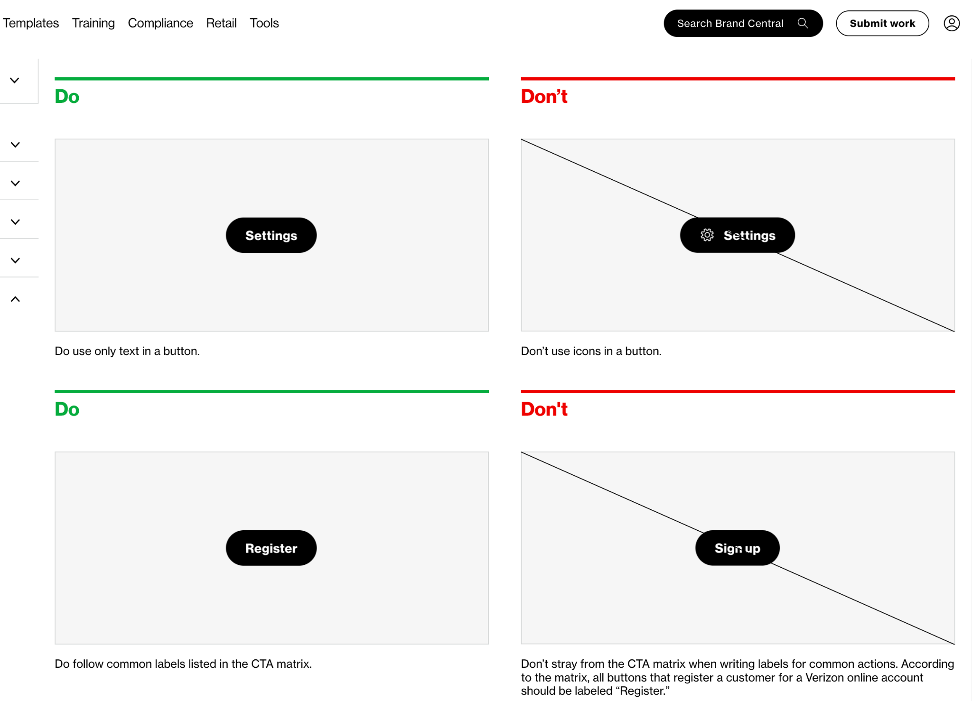
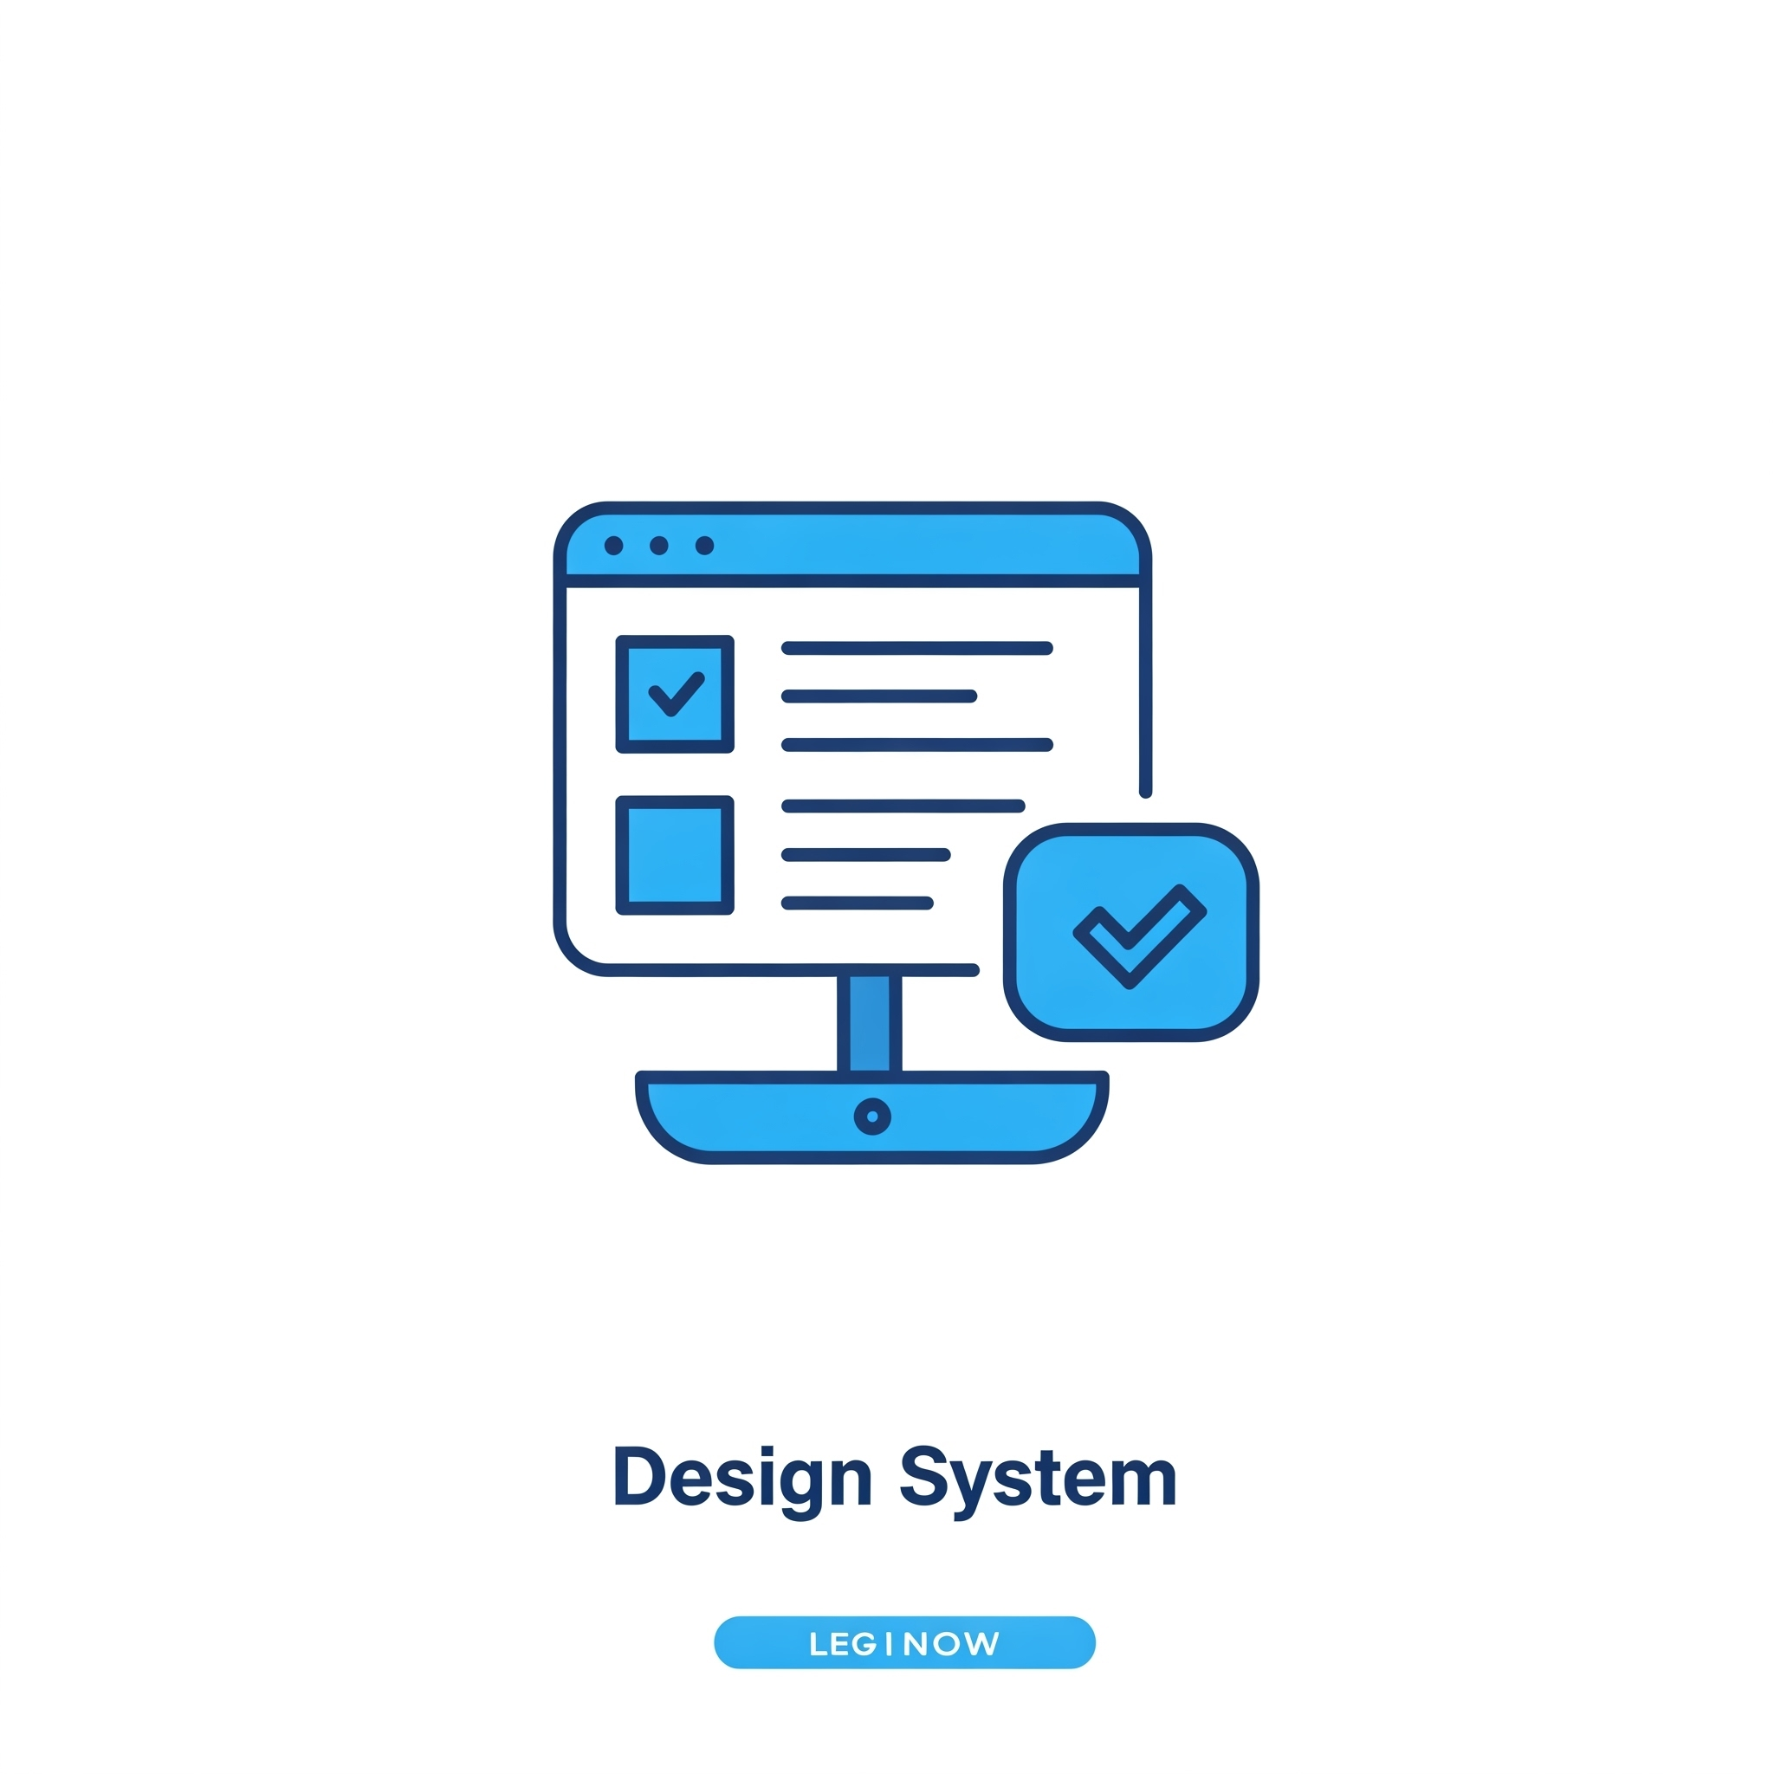

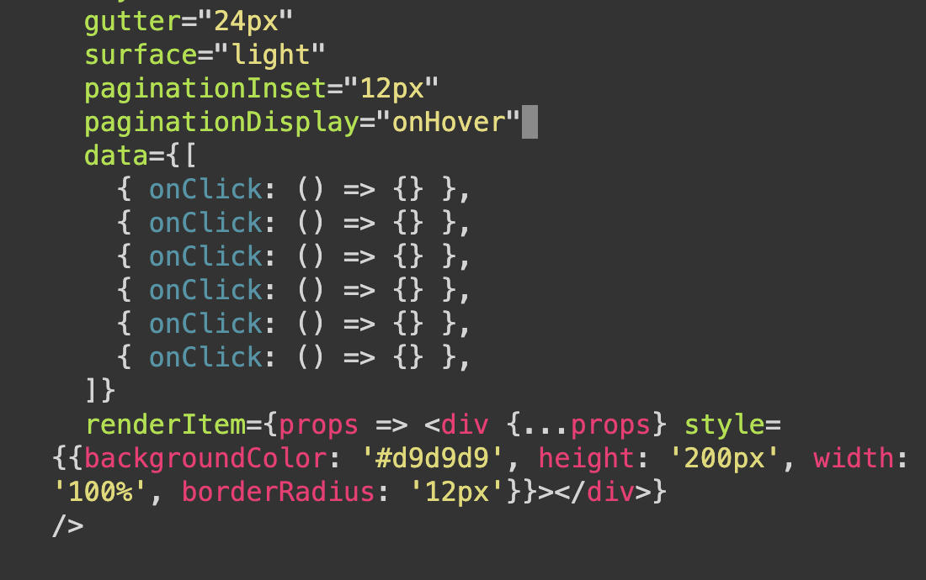
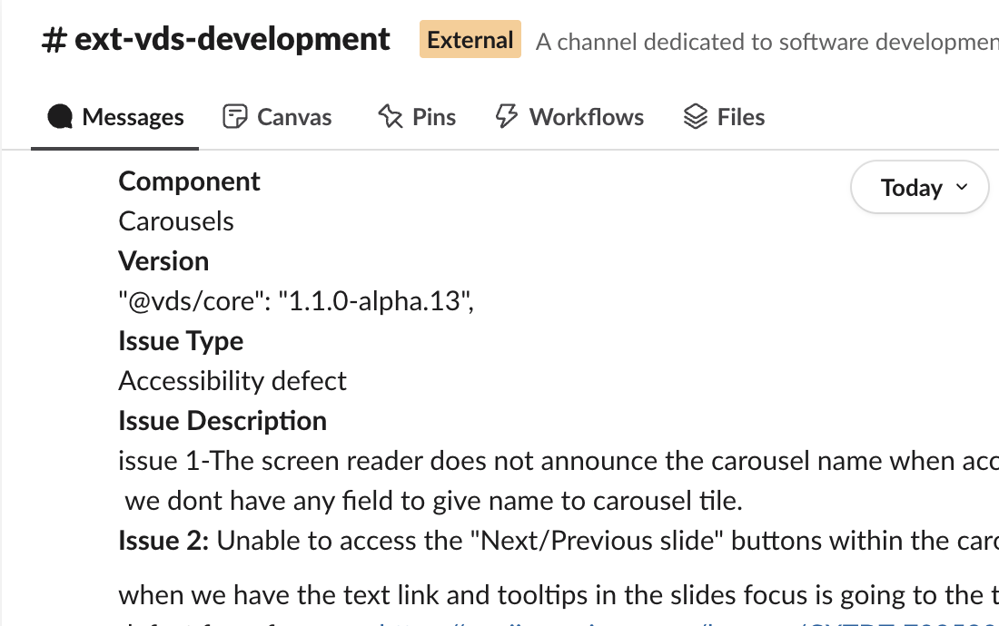
Northstar
Scope
Results
VDS Native Library
Journey Map Template
Documentation & Guidelines
Our VDS Native Library will feature comprehensive documentation and clear guidelines, serving as the single source of truth for both designers and developers. These accessible resources detail native principles, component APIs, platform-specific usage (iOS/Android), accessibility standards, and contribution models. The impact is immediate: teams are empowered with actionable knowledge, speeding up onboarding and ensuring consistent, high-quality, and compliant native experiences.
Native Figma Components
Designers creating native app experiences will benefit from a hybrid VDS Figma approach.
Existing VDS web components will be used where suitable for native, ensuring cross-platform consistency. This is complemented by a new, dedicated VDS Native Figma library for any uniquely mobile UI components, variants, and states.
This strategy, mainly for designers (devs for reference), speeds up native design, ensures UI fidelity, and improves handoff.
Native Coded Components (x2)
Developers will primarily utilize our production-ready VDS Coded Components for iOS (SwiftUI/UIKit) and Android (Jetpack Compose).
These easily installable, rigorously tested, and performant libraries are built with accessibility and theming at their core.
The impact is a dramatic reduction in native development time and effort, as these reusable building blocks minimize custom code, ensure consistency, improve quality, and free up developers to focus on core business logic.
Support & Feedback Both designers and developers will benefit from our dedicated VDS Native support channels, including a responsive Slack community and VDS team office hours.
With clear processes for bug reporting, feature requests, and feedback collection, we ensure continuous improvement.
This provides a crucial safety net, unblocking users quickly and fostering a collaborative partnership where feedback directly shapes a more robust, user-centric native library.

Slide 4
Expected Results
Northstar
Scope
Results
Expansion: VDS Native Library
KPI’s Impacted- Section 1
CX Excellence
❎ | Customer Satisfaction (CSAT) |  |  |  | ⬜ | Rep Interaction Score (RIS) |  |  |  | ⬜ | Churn Reduction
⬜ | 3-day Resolve |  |  |  | ❎ | Digital Interaction Score (DIS)
Revenue Growth
⬜ | Service Product Revenue |  |  |  |  | ❎ | Overall Conversion
⬜ | Service Product Revenue |  |  |  |  | ❎ | Prospect Conversion
Operational Efficiency
⬜ | Call Volume Optimization (CVO) |  |  |  |  |  | ⬜ | Average Handle Time (AHT)
⬜ | Retail Transaction Time |  |  |  |  |  | ❎ | Other Cost Savings
Financial Scope & Targets (P*Q)- Section 2
Benefit Value Estimates
Incremental Revenue $_______ Call Volume Optimization $________ Handle Time Optimization $_______ Other Benefit Value $_8.1M_______ (please explain)
Investment Planning - Section 3 (CXO IPG to complete this section)
Capital Investment Estimates
GTS Labor estimate $__________ Non-GTS estimate $__________
Operating Expense for Initiative (Incremental) CXO Operating Cost (OPEX) $________ CXO Incremental Headcount ________
Notes:
Add in a grey box over area that business should not complete for clarity, re-org details

Slide 5
Master Artifact
VDS Retail Expansion
Andrew Pendleton
CX Design Systems
Core Product
Project

Slide 6
VDS Retail Expansion
VDS Product: Expansion Strategy
Workstream Lead: Andrew Pendleton
Initiative Lead: Andrew Pendleton
Northstar
Scope
Results
The Idea
Problem & Opportunity
Our vital in-store digital experiences (kiosks, POS, displays) currently operate without dedicated VDS components. The teams are able to utilize our core VDS component set but these do not fully meet the specific challenges faced within the Retail channel. The lack of Retail specific components creates a critical gap, risking inconsistent branding, slower rollouts, and subpar user engagement where customers make key decisions. We don’t want to miss the opportunity to deliver truly unified, high-quality experiences in our retail footprint.
Proposed Solution
Introducing "VDS for Retail": a purpose-built expansion of our core VDS, tailored for the unique demands of in-store digital interfaces. Retail designers will define the components, and the VDS team will initially develop them, ensuring quality and consistency. This provides a ready-made, expert toolkit to transform our retail digital presence.
Customer Impact
Retail design and development teams will be empowered with VDS components crafted specifically for their unique environments. This means faster design cycles, streamlined development, and the ability to rapidly deploy consistent, high-quality, and accessible retail experiences. They can focus on retail innovation, backed by VDS precision.
Business Impact
This initiative will electrify our in-store brand presence and customer engagement on all retail digital touchpoints. Expect improved transaction speed, enhanced customer satisfaction in stores, and a stronger, unified brand story. Crucially, "VDS for Retail" validates a scalable model for future VDS specializations, boosting system ROI and adaptability.
This initiative will deliver a specialized VDS toolkit for our unique Retail experiences, kiosks, POS, passive displays, ensuring seamless, on-brand customer interactions. This is creating a new model for VDS: a core system that grows through expansion packs to better support every customer touchpoint.

Slide 7
Northstar
Scope
Results
VDS Retail Expansion
Journey Map Template
Documentation & Guidelines
The VDS Retail expansion will feature comprehensive documentation and clear guidelines, serving as the single source of truth for developers. These resources will detail retail specific principles, component APIs, platform-specific usage, accessibility standards, and contribution models. The impact is immediate: teams are empowered with actionable knowledge, speeding up onboarding and ensuring consistent, high-quality, and compliant retail experiences.
React Coded Components
Developers will primarily utilize our production-ready VDS Coded Components for React development.
These easily installable, rigorously tested, and performant libraries are built with accessibility and theming at their core.
The impact is a dramatic reduction in retail development time and effort, as these reusable building blocks minimize custom code, ensure consistency, improve quality, and free up developers to focus on core business logic.
Support & Feedback Developers will benefit from our VDS Retail support channels, including a responsive Slack community and VDS team office hours.
With clear processes for bug reporting, feature requests, and feedback collection, we ensure continuous improvement.
This provides a crucial safety net, unblocking users quickly and fostering a collaborative partnership where feedback directly shapes a more robust, user-centric native library.

Slide 8
Expected Results
Northstar
Scope
Results
CX Workstream Name
KPI’s Impacted- Section 1
CX Excellence
⬜ | Customer Satisfaction (CSAT) |  |  |  | ⬜ | Rep Interaction Score (RIS) |  |  |  | ⬜ | Churn Reduction
⬜ | 3-day Resolve |  |  |  | ⬜ | Digital Interaction Score (DIS)
Revenue Growth
⬜ | Service Product Revenue |  |  |  |  | ⬜ | Overall Conversion
⬜ | Service Product Revenue |  |  |  |  | ⬜ | Prospect Conversion
Operational Efficiency
❎ | Call Volume Optimization (CVO) |  |  |  |  |  | ⬜ | Average Handle Time (AHT)
⬜ | Retail Transaction Time |  |  |  |  |  | ⬜ | Other Cost Savings
Financial Scope & Targets (P*Q)- Section 2
Benefit Value Estimates
Incremental Revenue $_______ Call Volume Optimization $________ Handle Time Optimization $_______ Other Benefit Value $________ (please explain)
Investment Planning - Section 3 (CXO IPG to complete this section)
Capital Investment Estimates
GTS Labor estimate $__________ Non-GTS estimate $__________
Operating Expense for Initiative (Incremental) CXO Operating Cost (OPEX) $________ CXO Incremental Headcount ________
Notes:
Add in a grey box over area that business should not complete for clarity, re-org details

Slide 9
Master Artifact
VDS Conversational Expansion
Andrew Pendleton
CX Design Systems
Core Product
Project

Slide 10
VDS Conversational Expansion
VDS Product: Expansion Strategy
Workstream Lead: Andrew Pendleton
Initiative Lead: Andrew Pendleton
Northstar
Scope
Results
The Idea
Problem & Opportunity
While we have design guidance for the Verizon Assistant, our teams lack a centralized library of VDS-developed coded UI components for its screen interactions. This forces redundant effort, risks visual and behavioral inconsistencies across platforms, slows down innovation in conversational AI, and ultimately dilutes the Assistant's brand power.
Proposed Solution
VDS will take the lead in developing and delivering a comprehensive suite of coded UI components based on the existing VDS Conversational Expansion Pack [CONV]. This means production-ready, VDS-quality assets for all screen-based Assistant UIs, ensuring teams can build fast and consistently, with a planned handoff to the Conversational Dev team for long-term ownership.
Customer Impact
Teams building Verizon Assistant screen experiences will get a massive upgrade. Developers gain access to robust, pre-built VDS components, slashing development time and ensuring consistency with design specs. Designers will see their vision for conversational UI flawlessly executed, enabling everyone to focus on innovation and user flow excellence.
Business Impact
This investment will transform our Verizon Assistant into a consistently premium and engaging brand touchpoint on all screens. Expect faster deployment of new Assistant features, improved customer interaction quality, and significant development efficiencies. This solidifies Verizon's voice, enhances user trust, and boosts the ROI of our conversational AI strategy.
We’d like to empower every screen-based Verizon Assistant interaction with unparalleled quality and consistency. This initiative will deliver a VDS-developed component library that ensures our conversational UI is not just functional, but a truly seamless, on-brand, and delightful experience for customers on any device—mobile, tablet, or desktop.

Slide 11
Northstar
Scope
Results
VDS Native Library
Journey Map Template
Documentation & Guidelines
The VDS Conversational expansion will feature comprehensive documentation and clear guidelines, serving as the single source of truth for developers. These resources will detail retail specific principles, component APIs, platform-specific usage, accessibility standards, and contribution models. The impact is immediate: teams are empowered with actionable knowledge, speeding up onboarding and ensuring consistent, high-quality, and compliant retail experiences.
React Coded Components
Developers will primarily utilize our production-ready VDS Coded Components for React development.
These easily installable, rigorously tested, and performant libraries are built with accessibility and theming at their core.
The impact is a dramatic reduction in conversational development time and effort, as these reusable building blocks minimize custom code, ensure consistency, improve quality, and free up developers to focus on core business logic.
Support & Feedback Developers will benefit from our VDS Conversational support channels, including a responsive Slack community and VDS team office hours.
With clear processes for bug reporting, feature requests, and feedback collection, we ensure continuous improvement.
This provides a crucial safety net, unblocking users quickly and fostering a collaborative partnership where feedback directly shapes a more robust, user-centric native library.

Slide 12
Expected Results
Northstar
Scope
Results
CX Workstream Name
KPI’s Impacted- Section 1
CX Excellence
⬜ | Customer Satisfaction (CSAT) |  |  |  | ⬜ | Rep Interaction Score (RIS) |  |  |  | ⬜ | Churn Reduction
⬜ | 3-day Resolve |  |  |  | ⬜ | Digital Interaction Score (DIS)
Revenue Growth
⬜ | Service Product Revenue |  |  |  |  | ⬜ | Overall Conversion
⬜ | Service Product Revenue |  |  |  |  | ⬜ | Prospect Conversion
Operational Efficiency
❎ | Call Volume Optimization (CVO) |  |  |  |  |  | ⬜ | Average Handle Time (AHT)
⬜ | Retail Transaction Time |  |  |  |  |  | ⬜ | Other Cost Savings
Financial Scope & Targets (P*Q)- Section 2
Benefit Value Estimates
Incremental Revenue $_______ Call Volume Optimization $________ Handle Time Optimization $_______ Other Benefit Value $________ (please explain)
Investment Planning - Section 3 (CXO IPG to complete this section)
Capital Investment Estimates
GTS Labor estimate $__________ Non-GTS estimate $__________
Operating Expense for Initiative (Incremental) CXO Operating Cost (OPEX) $________ CXO Incremental Headcount ________
Notes:
Add in a grey box over area that business should not complete for clarity, re-org details

Slide 13
Master Artifact
VDS AI Tooling
Andrew Pendleton
CX Design Systems
Core Product
Project

Slide 14
VDS AI Tooling
VDS Product: Operational Efficiency
Workstream Lead: Andrew Pendleton
Initiative Lead: Andrew Pendleton
Northstar
Scope
Results
The Idea
Problem & Opportunity
Today, using VDS involves manual searches, context switching for support in Slack, and tedious VDS team effort answering repetitive questions. This friction slows down our designers and developers, breeds inconsistency, and drains resources. Valuable time is lost on manual visual audits and VQA, delaying innovation and time-to-market.
Proposed Solution
Introducing VDS AI Tooling: A suite of intelligent assistants! A Figma plugin (VDS Design Assistant) and VS Code extension (VDS Dev Assistant) will provide instant, in-context access to VDS components, guidelines, and an AI chatbot. Plus, a powerful Similarity Engine will automate visual audits and unlock new design capabilities.
Customer Impact
Designers & developers get a VDS AI co-pilot! They'll access VDS assets & answers instantly within Figma/VS Code, slashing friction & search time. Expect unprecedented efficiency, faster onboarding, higher quality outputs, and greater confidence in applying VDS correctly. This means more time creating, less time wrestling with tools or seeking help.
Business Impact
VDS AI Tooling will ignite development speed, dramatically cut VDS support costs, and elevate product quality & consistency across all Verizon experiences. By automating tedious tasks like visual audits and providing intelligent support, we unlock significant efficiency gains, accelerate innovation, and amplify the ROI of our entire VDS ecosystem.
Revolutionizing how teams build by embedding AI-powered VDS intelligence directly into design and development workflows. Transforming VDS into an intuitive, proactive AI partner in Figma & VS Code, ensuring effortless adoption, perfect consistency, and supercharged productivity for every user, on every project.

Slide 15
Northstar
Scope
Results
VDS AI Tooling
Journey Map Template
VDS Design Assistant
Sitting right inside Figma, the VDS Design Assistant watches what you’re drawing and quietly points you to the exact component, token, or spacing rule that fits, then flags anything that drifts.
It cuts the back-and-forth review cycle to minutes, so designers spend more time exploring ideas and less time hunting for “the right way.”
Over time it learns from real projects, so its nudges get sharper without adding noise.
Impact: Smoother hand-offs and consistently on-brand interfaces, without extra meetings or retraining.
VDS Development Assistant
Running in VS Code, our devs’ natural habitat, the VDS Developer Assistant autocompletes imports, shows prop examples, and warns when code veers off spec or a newer component version is available.
It trims setup and PR cleanup, letting engineers focus on features while knowing their build will pass design-system checks the first time.
Built-in support for test frameworks and CI hooks drops seamlessly into existing pipelines with almost no extra setup.
Impact: cleaner merges, fewer late-stage bugs, and faster releases that look and behave exactly as intended.
Similarity Engine
An AI tool that scans the CX Design Figma workspace to quickly find duplicate, inconsistent, or off-brand components.
This will enable the VDS team to spot patterns, clean up design drift, and keep experience design work aligned with minimal manual audits. This engine will also be able to power other AI tools for adopters by providing accurate, real-time design pattern data—fueling assistants that suggest the right components, flag inconsistencies, or automate VQA during design and development.
Impact: higher quality and consistency across the entire Verizon ecosystem at scale.

Slide 16
Expected Results
Northstar
Scope
Results
CX Workstream Name
KPI’s Impacted- Section 1
CX Excellence
⬜ | Customer Satisfaction (CSAT) |  |  |  | ⬜ | Rep Interaction Score (RIS) |  |  |  | ⬜ | Churn Reduction
⬜ | 3-day Resolve |  |  |  | ⬜ | Digital Interaction Score (DIS)
Revenue Growth
⬜ | Service Product Revenue |  |  |  |  | ⬜ | Overall Conversion
⬜ | Service Product Revenue |  |  |  |  | ⬜ | Prospect Conversion
Operational Efficiency
❎ | Call Volume Optimization (CVO) |  |  |  |  |  | ⬜ | Average Handle Time (AHT)
⬜ | Retail Transaction Time |  |  |  |  |  | ⬜ | Other Cost Savings
Financial Scope & Targets (P*Q)- Section 2
Benefit Value Estimates
Incremental Revenue $_______ Call Volume Optimization $________ Handle Time Optimization $_______ Other Benefit Value $________ (please explain)
Investment Planning - Section 3 (CXO IPG to complete this section)
Capital Investment Estimates
GTS Labor estimate $__________ Non-GTS estimate $__________
Operating Expense for Initiative (Incremental) CXO Operating Cost (OPEX) $________ CXO Incremental Headcount ________
Notes:
Add in a grey box over area that business should not complete for clarity, re-org details

Slide 18
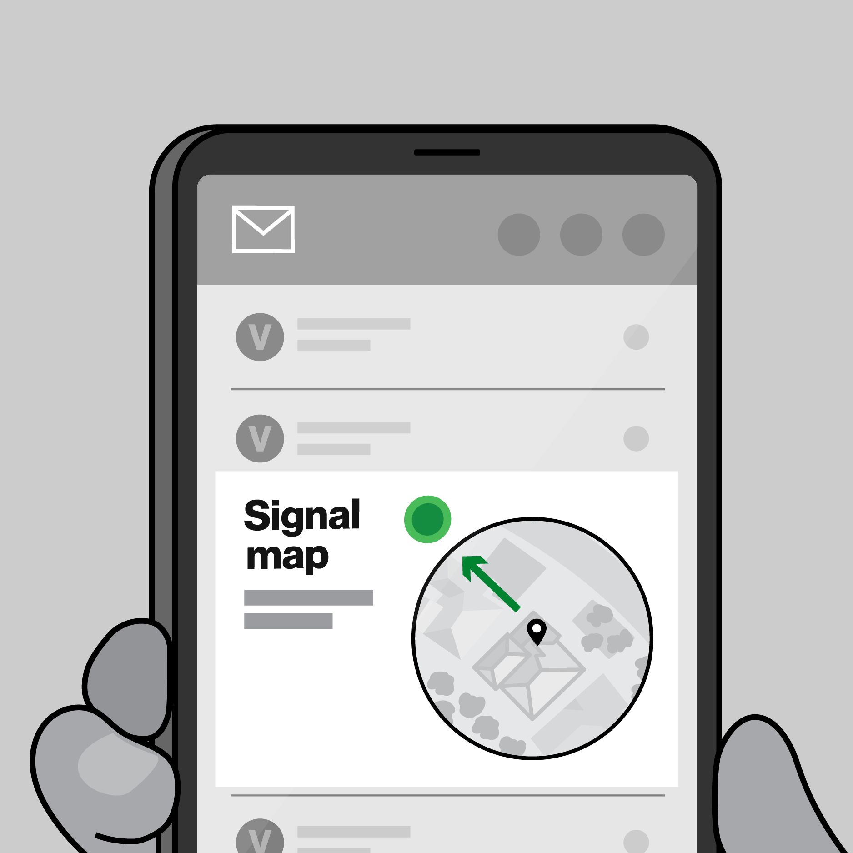
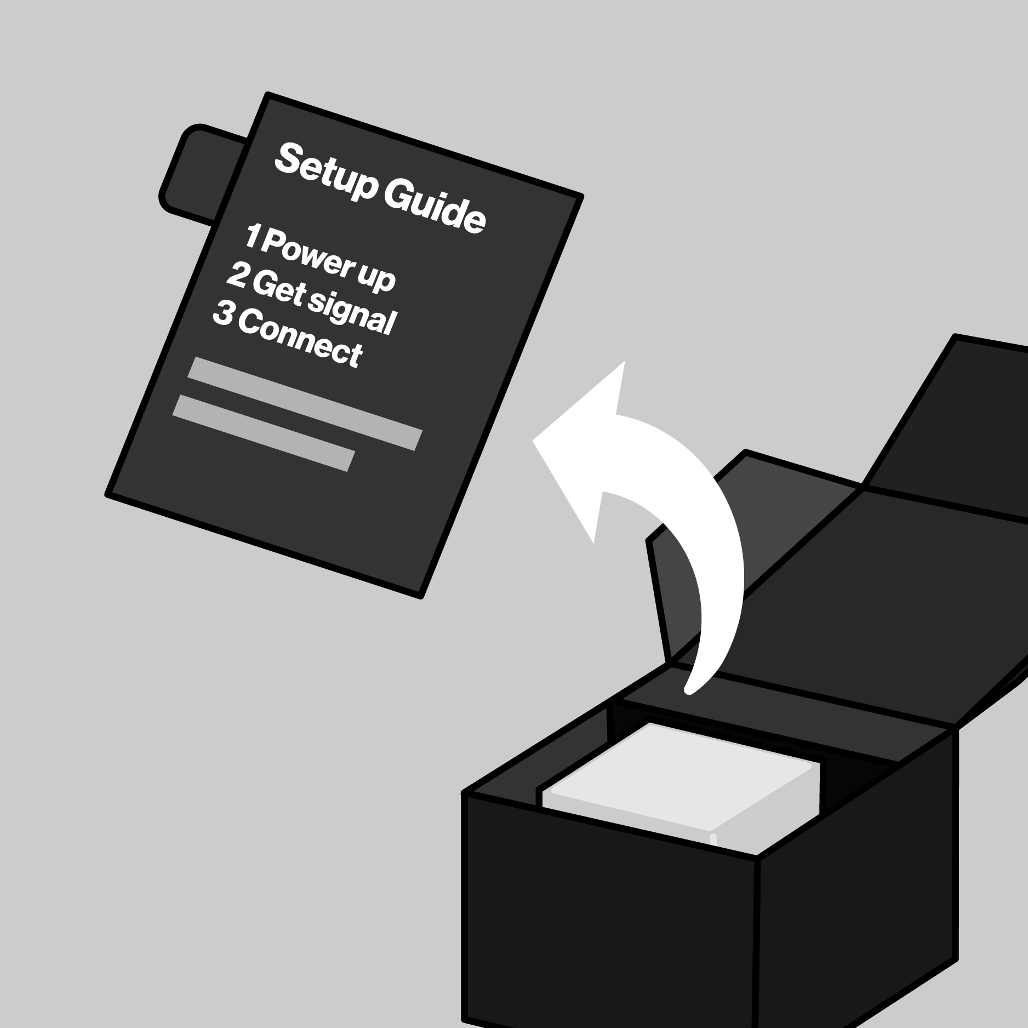



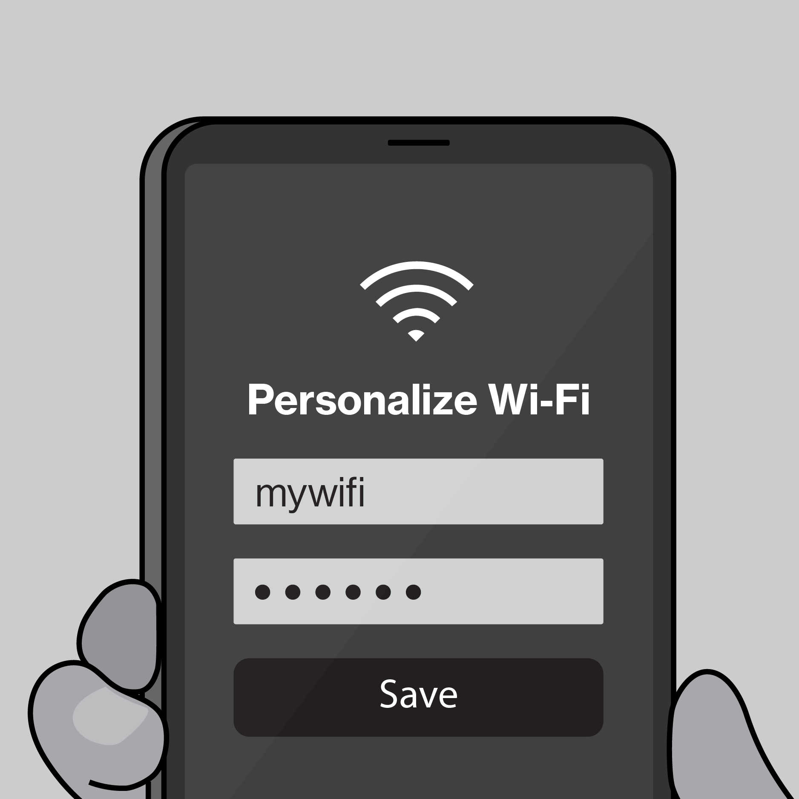

Example
2026 Planning Artifacts
Journey Map Example
Post-Sale / Pre-Setup
Taylor gets a confirmation email to set her up for success.
1. Unbox
On opening the box, Taylor sees a simple 1-2-3 set of instructions for setup
2. Find a spot
Using what she learned in-store, she chooses a spot to plug-in.
3. Activate internet
When the light turns solid white she’s setup. If help is needed, she refers to the 5G Compass in MVA.
Download / Open MVA
If Taylor wants to personalize her network, she can scan the QR code or enter the URL to deep link in My Verizon app.
Personalize internet
Once she has the My Verizon app open, there are a variety of personalizations and settings that she can change.
Key interactions
Confirmation email / Get ready page
Register
Download MVA
5G signal map + compass
Setup guide
Device
Power adapter
LED status
Wi-Fi name/password
5G signal map + compass
Setup guide
My Verizon app
Authentication
My Verizon app
Set Wi-Fi name/password
Connect devices

Slide 19
Master Artifacts
Due 5/19

Slide 20
Appendix

Slide 21
Master Artifact
Initiative Name
Submitter Name
Band 5 Team Name
Core Product
Project

Slide 22
Initiative Name
Workstream Name
Workstream Lead: Name
Initiative Lead: Name
Template
Northstar
Scope
Results
Strategic Themes
[EXAMPLE] Customer need or problem being solved
Giving customers visibility and creating end to end ownership on issues that we cannot resolve on the initial interaction
Customer need or problem is being solved
[What will be unlocked for the customer or business?]
Customer need or problem being solved
[What will be unlocked for the customer or business?]
Customer need or problem being solved
[What will be unlocked for the customer or business?]
Customer need or problem being solved
[What will be unlocked for the customer or business?]
[Northstar statement - Ambition Here]

Slide 23
Template
Northstar
Scope
Results
CX Workstream Name
Journey Map Template
Illustrative Only
Key Customer Actions
Description customer objectives and actions
Key Customer Actions
Description customer objectives and interactions
Key Customer Actions
Description customer objectives and interactions
Key Customer Actions Description customer objectives and interactions
Key Customer Actions
Description customer objectives and interactions
Key Customer Actions
Description customer objectives and interactions
Key interactions
Key Interactions w/ Verizon
Key Interactions w/ Verizon
Key Interactions w/ Verizon
Key Interactions w/ Verizon
Key Interactions w/ Verizon
Key Interactions w/ Verizon

Slide 24
Expected Results
Template
Northstar
Scope
Results
CX Workstream Name
KPI’s Impacted- Section 1
CX Excellence
⬜ | Customer Satisfaction (CSAT) |  |  |  | ⬜ | Rep Interaction Score (RIS) |  |  |  | ⬜ | Churn Reduction
⬜ | 3-day Resolve |  |  |  | ⬜ | Digital Interaction Score (DIS)
Revenue Growth
⬜ | Service Product Revenue |  |  |  |  | ⬜ | Overall Conversion
⬜ | Service Product Revenue |  |  |  |  | ⬜ | Prospect Conversion
Operational Efficiency
❎ | Call Volume Optimization (CVO) |  |  |  |  |  | ⬜ | Average Handle Time (AHT)
⬜ | Retail Transaction Time |  |  |  |  |  | ⬜ | Other Cost Savings
Financial Scope & Targets (P*Q)- Section 2
Benefit Value Estimates
Incremental Revenue $_______ Call Volume Optimization $________ Handle Time Optimization $_______ Other Benefit Value $________ (please explain)
Investment Planning - Section 3 (CXO IPG to complete this section)
Capital Investment Estimates
GTS Labor estimate $__________ Non-GTS estimate $__________
Operating Expense for Initiative (Incremental) CXO Operating Cost (OPEX) $________ CXO Incremental Headcount ________
Notes:
Add in a grey box over area that business should not complete for clarity, re-org details

Slide 25
2026 Capex + Opex Incremental
Northstar
Scope
Results
Xxx (i.e. Koenders, Butler etc.) | xxx (i.e. CX, Experience Product, Digital Channel etc.)
Status | Opex ID | Product Area | EMR (see notes) | Initiative Name | Vendor Name | Description | Budget
C | Opex-xxx | Assisted Experience | Contracted Services | <Name> | <Vendor> | <Description> | $XXX.XX
N | New
C | Continue
S | Stop
Notes:
Expense Management Record (EMR) Categories
Advertising and Promotion
Contracted Services
Direct Costs
Full Time Labor
HR and Training
IT and Technology Contracts
Other Operating Costs
Overhead Costs
Professional Services Fees
Sales Incentives
Temporary Labor
Travel and Internal Events

Slide 26
2026 Opex Only
Northstar
Scope
Results
Xxx (i.e. Koenders, Butler etc.) | xxx (i.e. CX, Experience Product, Digital Channel etc.)
Status | Opex ID | Product Area | EMR (see notes) | Initiative Name | Vendor Name | Description | Budget
C | Opex-xxx | Assisted Experience | Contracted Services | <Name> | <Vendor> | <Description> | $XXX.XX
N | New
C | Continue
S | Stop
Notes:
Expense Management Record (EMR) Categories
Advertising and Promotion
Contracted Services
Direct Costs
Full Time Labor
HR and Training
IT and Technology Contracts
Other Operating Costs
Overhead Costs
Professional Services Fees
Sales Incentives
Temporary Labor
Travel and Internal Events

